Slide 1
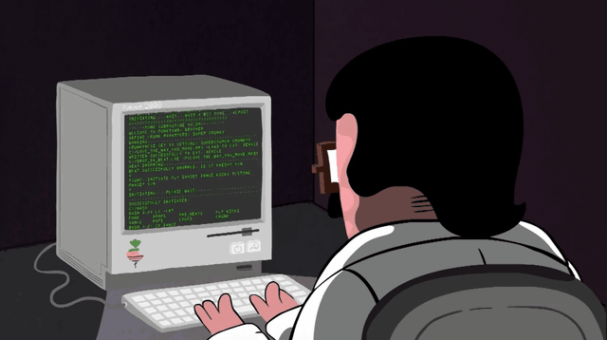
Programming Constructs
Mr Butler | Chapter 24

Slide 2
The Specification
demonstrate understanding of and use the functionality of the following constructs in a programming language:
  variables, constants, and Boolean and arithmetic operators;
  input, output and assignment statements;
  one-dimensional array structures;
  simple sorting techniques such as the bubble sort and the insertion sort;
  simple searching techniques such as linear and binary searching;
  string manipulation functions, including splitting, concatenating, character searching and substring searching;
  controlling the flow of a program through sequence, selection and iteration;
  building reusable code that utilises user-defined functions or methods; and
  basic file handling.

Slide 3


The Difference Between Variables & Constants
Both must be given a data type
int double
string char
bool datetime
Both must be given a NAME
We use camelCase when naming:
Starts with a lower case letter
No spaces, instead we capitalise each new word.
Variables
A named location in computer memory which holds a value. It must be given a name and data type. The value held at this location can change during program execution.
50
The Syntax
To create a variable, follow this pattern:
Constants
A named location in computer memory which holds a value. It must be given a name and data type. The value held does not change during program execution.
score
[int]
🏴󠁢󠁳󠁢󠁰󠁿 Remember
Don’t forget the semicolon (;) at the end of the statement. It tells the computer the instruction is finished.
data type
variable name
value

Slide 4
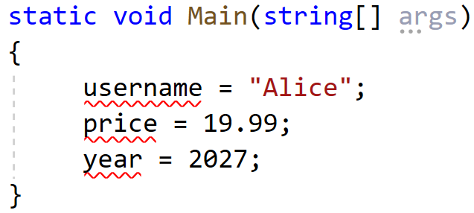
Fix the code
Below is a screenshot of Tom, who is trying to declare three variables.
Correct the code by entering in a suitable data type for each variable
🏴󠁢󠁳󠁢󠁰󠁿 Remember
Declaring variables always start with stating the data type first! i.e.
int age = 41;

Slide 5
Displaying Your Data
Console.WriteLine()
You can combine text and variables using the + symbol (this is called concatenation).
If the variable is declared as
Writing
Will output

Slide 6
Coding Challenge: Digital ID Card
The Task
Write a program storing profile information in variables, then print it.
These all need to be stored in variables
📖 Example
Goal Output:
My Name is Alex.
I am 15 years old.
I am 1.8m tall.
My Favourite sport is Rugby.
📘 Extension
Goal Output:
My Name is Alex.
I will be 25 years old in 10 years time.
I am 1.8m tall.
My Favourite sport is Rugby.

Slide 7
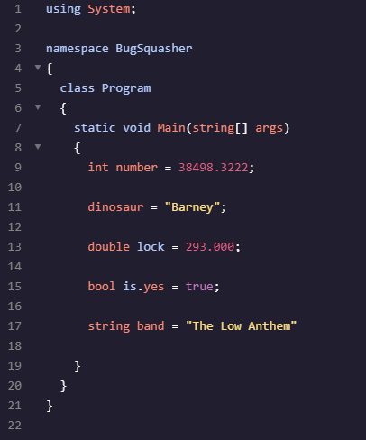
Activity: What’s wrong here then?
TASK
There are 5 errors in this code snippet. Copy out this snippet and highlight/circle the errors.
Annotate how or what the correct solution should be!

Slide 8
Solutions
There are 5 errors in this code snippet. Copy out this snippet and highlight/circle the errors.
Annotate how or what the correct solution should be!
An integer (int) must be a whole number
A variable must be declared with a specific type
A double can only have 2 decimal places
A variable name cannot have a full stop/symbol
A statement must end with a semi colon (;)
Mark yourself out of 5!

Slide 9
Making Programs Interactive in C#
Imagine a world where apps didn't listen to you.
No search bars, no login screens, and no game controls. Boring, right? To make software useful, we need to gather data from the user and react to it.
🔑 Key Point
Interactive programs follow a simple flow:
Input 👉 Process 👉 Output

Slide 10
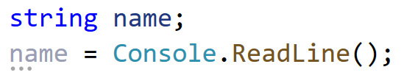
Capturing Data with Console.ReadLine()
Use Conosle.ReadLine() to pause the program until the user types text and presses Enter.
name
[string]
The Program waits for user input
🔑 Remember
Console.ReadLine() always returns data as a ‘string’, even if the user types in a number

Slide 11
Check Yourself (before you wreck yourself!)
To store a person’s name, you first declare a ____________ variable, then use ________________ to capture their typing.
If you wanted to store their age, you would declare a variable called age with a data type of _________________.
To output the value stored within a variable, you would use the _________________ method.
string
Console.ReadLine()
int
Console.WriteLine()
Word Bank
String Console.WriteLine() int Console.ReadLine()

Slide 12
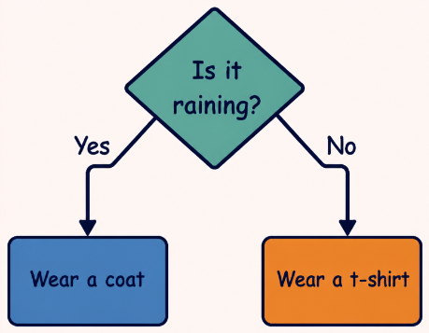
Making Choices: The IF Statement
Logic is about choices.
An IF statement tells the computer to run a block of code only if a specific condition is true. If it isn't true, we can use to provide a backup plan.
==
Checks if two values are equal
> and <
Checks if two values are greater or less than

Slide 13
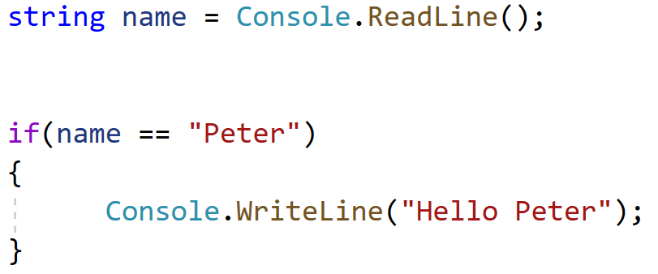
Code Structure: Input + Logic
⚠️ Watch Out!
Unlike in Maths, C# uses double equals sign (==) to compare things. A single equals sign (=) is only for assigning values.
The Code Pattern
Within the brackets goes the condition
If the condition is true, then the code within the { and } runs.

Slide 14

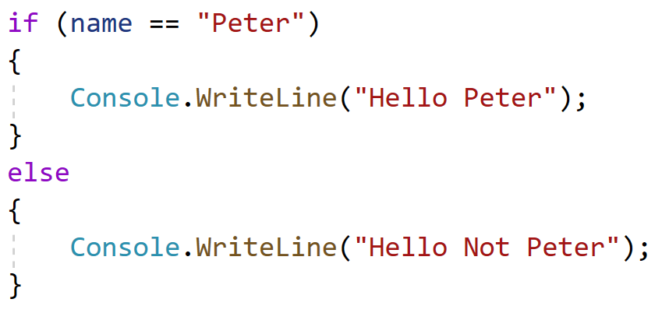
The IF statement can also have an optional attachment called the ELSE statement.
It runs if the condition false

Slide 15
Operator Check
In C#, the code if(age = 18) is the correct way to check if someone is 18
👍
👎
TRUE
FALSE

Slide 16
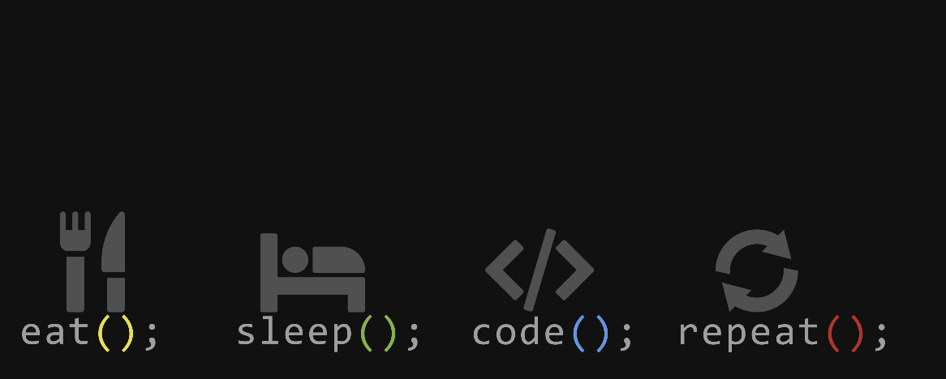
The Power of Repetition
Why do we need loops?
Imagine writing a program to print 'Hello World' 1,000 times. You could copy and paste 1,000 lines, but what if you needed to change the message later?
Loops allow us to write a block of code once and run it as many times as needed.
📖 Key Point
Loops make code shorter, easier to read, and much more maintainable. This is the ‘DRY’ principle:
Don’t Repeat Yourself

Slide 17
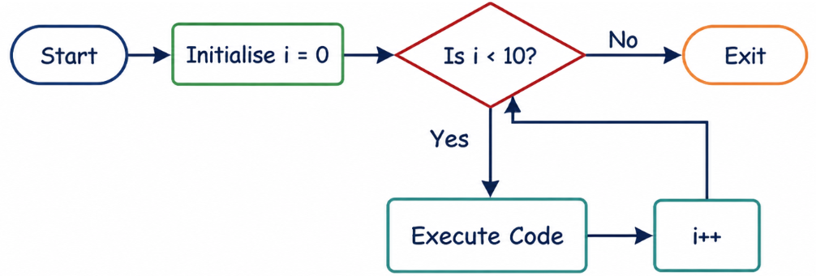
The FOR Loop Structure
A For loop is used when you know exactly how many times you want to repeat a task – this is called a count controlled loop. It uses a counter to keep track of the repetitions.
This is a fancy looking piece of code. But all it does is increase (increment) i by 1.

Slide 18
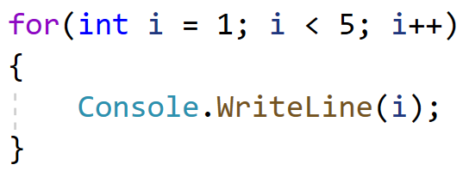
Anatomy of a For Loop
In C#, the for loop has three parts:
Initialiser: Where the counter starts (e.g., int i = 0).
Condition: How long to keep going (e.g., i < 10).
Iterator: How to update the counter (e.g., i++).
Initialiser
Where the counter starts
Condition
How long to keep going
📖 Example
Printing 1 to 5:
Iterator
How to update the counter

Slide 19
Check your Knowledge!
Which part of the for loop defines when the loop should stop running?
Which part of the for loop defines the counter?
Which part of the for loop increases the counter after each repetition?
The Initialiser
The Condition
The Iterator
The Curly Braces
The Initialiser
The Condition
The Iterator
The Curly Braces
The Initialiser
The Condition
The Iterator
The Curly Braces

Slide 20
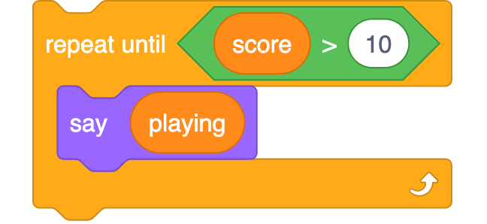
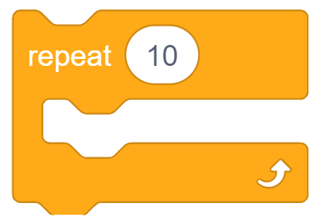
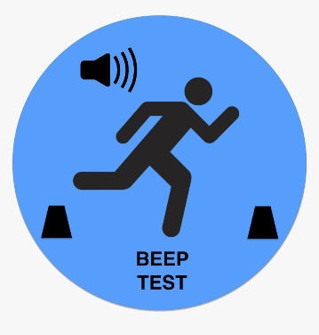
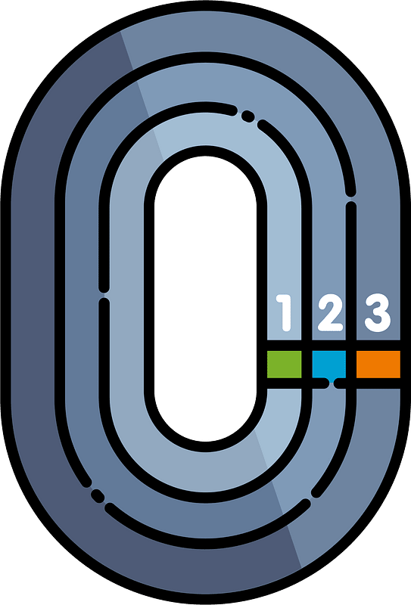
Going around in circles? MORE LOOPS?
The WHILE Loop
This is best for indefinite iteration, where we don’t know how many times it will run – like waiting for a user to enter the correct password
The FOR Loop
This is best for definite iteration, where we know how many times we want to repeat.
⚠️ Watch Out!
Scratch doesn’t actually have an explicit “WHILE” loop, so this repeat until loop actually does the opposite – when the condition becomes true.

Slide 21
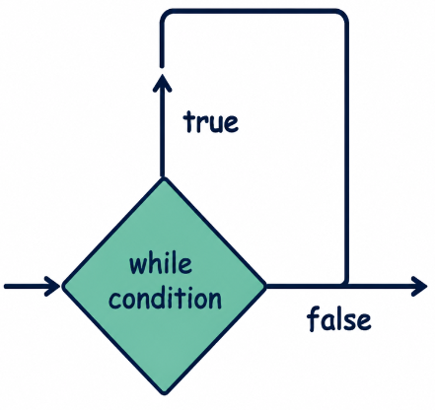
Anatomy of a While Loop
The while loop checks a condition before executing the code block. If the condition is true, the code runs, then it checks again.
Logic Flow
Check Condition
Run Code (if true)
Repeat until false

Slide 22
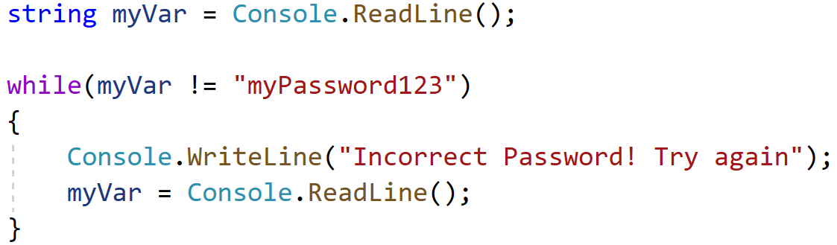
The WHILE loop is fairly straightforward to write, as it looks a lot like the if statement we learnt previously. This time, however,
📖 Key Point
!= means not equals to (≠) in C#
We don’t know how many times the user will enter in the password incorrectly, but this will repeat until the user enters in the correct password

Slide 23
Choosing the Right Tool
A key skill in programming is knowing when to use a For Loop (definite iteration) and when to use a While Loop (indefinite iteration).
Read the scenarios below. Decide which loop type is best and briefly explain why.
Scenario | Loop Type & Reason
Printing the 12 times table for a specific number.
Waiting for a user to type in the correct password to log into a computer system.
A game where a player keeps guessing a secret number until they get it right.
For Loop (We know exactly how many times it needs to run - 12 times)
While Loop (We don't know how many attempts the user will take)
While Loop (We don't know how many guesses it will take before the condition becomes true)

Slide 24
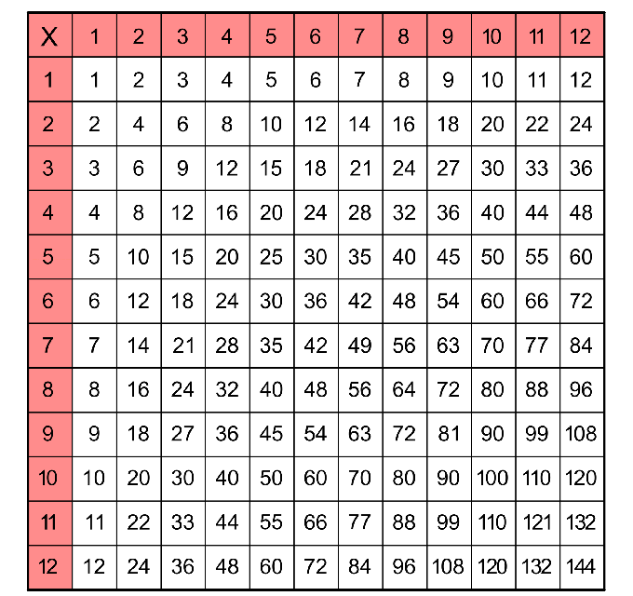
Task: Times Table Generator
Write a C# program using a for loop that asks the user for a number and then prints the multiplication table for that number from 1 to 12.
Challenge:
Use a while loop to keep asking for a new number until the user types 'exit'.

Slide 25
Explain it to a 10 Year Old
One of the biggest dangers of a While loop is creating an Infinite Loop.
Imagine you have to explain what an Infinite Loop is to a 10-year-old. How would you describe it? Mention what causes it and what happens to the computer program as a result.
An infinite loop is like getting stuck on a roundabout and never being able to take the exit.
It happens when the condition to stop the loop never becomes false, so the computer keeps running the exact same code forever.
Eventually, it can cause the program to crash or freeze.

Slide 26
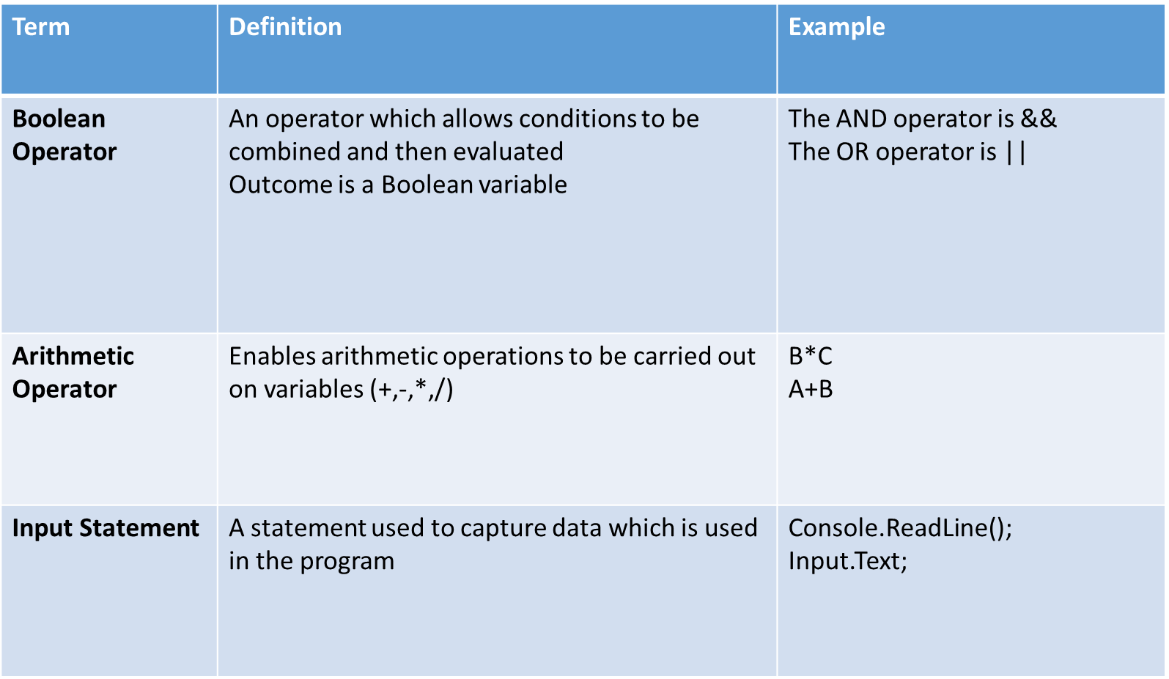
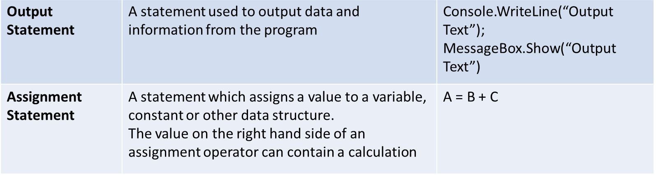
Features of Programming Languages

Slide 27
Arrays
Arrays are a special data structure which holds a set of data items of the same data type.
Unlike a single variable which only holds one value, an array is designed to hold multiple data items simultaneously.
When we declare an array, the computer reserves a set amount of memory locations next to each other (contiguous). And because the data is stored together in memory, there is faster processing, updating and deleting of data within the array.
Whilst the array is fixed in size when we first declare it, the values of each of the elements can be changed and updated during program execution.

Slide 28
Declaring an Array
It is assigned a name, a size (number of data items to store) and data type by the programmer
For example;
String[] records = New String[5]
It will be able to hold 5 pieces of data/text
This is an array which will contain string values
We have named it records

Slide 29
Using Arrays
An individual data item can be accessed by referring to the array name and the index (position) of the element
The trick is to remember that the first position is not 1 but in fact index 0
Element | records[0] | records[1] | records[2] | records[3] | records[4]
Position in array / Index | 0 | 1 | 2 | 3 | 4
Value | Alex | Peter | Ross | Hannah | Jenny

Slide 30
Looping through Arrays
The most common way of looping an array is using a FOR loop.
For(int i = 0; i < records.Length; i++)
{
Console.WriteLine(records[i]);
}
.Length is a special property which tells us the size of the array (the number of items it contains)
“i” is commonly used as the loop counter. In this case you can think of it as ‘index’
i++ is another way of writing i=i+1;
It is the incrementer for the loop.
At the end of the loop, this runs and increases the value of “i” by 1.
This is the condition which is checked at the start of the loop and then after each loop finishes.
This is a way we can reference the value stored at a specific index.

Slide 31
Sorting: BUBBLE SORT
FOR ( i = 0 TO myArray.Length )
FOR ( j = 0 TO myArray.Length )
IF ( myArray[j] > myArray[j+1] )
temp = myNumbers [j]
myArray[j] = myNumbers [j+1]
myArray [j+1] = temp
END IF
END FOR
END FOR
This section simply swaps the numbers around
Notes:
The bubble sort uses a loop (inside j loop) to move through an array comparing adjacent data items as it moves along.
If an array element [j] is greater than the element immediately to its right [j + 1], it swaps them.
The first time around, this process will bubble the largest value to the end of the array.
After N-1 passes, the data will be sorted.

Slide 32
Sorting: INSERTION SORT
FOR ( i = 0 TO myArray.Length )
positionOfMin = I
FOR ( j = i TO myArray.Length )
IF ( myArray[positionOfMin] > myNumbers[j] )
positionOfMin = j;
END IF
END FOR
temp = myArray[i]
myArray[i] = myNumbers[positionOfMin]
myArray[positionOfMin] = temp
END FOR
This section simply swaps the numbers around
Notes:
The insertion sort uses 2 loops. The first loop goes from 0 to array’s length (number of items in the array)
The second loop goes through from I to array.length, so from 0 to 10, 1 to 10, 2 to 10 and so on
This sort inserts each element of the array into its proper position, leaving larger stretches of the sub array sorted (the sorted sub list)
Then, the current element of the array is inserted into the proper position at the head of the array.

Slide 33
Simple Searching: Linear Search
SET i = 0
SET valueToFind = INPUT
SET found = False
WHILE ( i < array.Length AND found==false )
IF ( array[i] == valueToFind )
found = true
OUTPUT “Found at ” + array[i]
END IF
i = i + 1
END WHILE
IF ( found = FALSE )
OUTPUT “Value not found”
END IF

Slide 34
Simple Searching: Binary Search
SET lo = 0
SET term = valueToFind
SET hi = array.Length – 1
SET found = FALSE
Do
SET mid = 0.5 * ( lo + hi )
ROUND to nearest whole number
if(array[mid] = term)
SET found =TRUE
END IF
IF array[mid] < term
SET lo = mid + 1
END IF
IF array[mid] > term
SET hi = mid – 1
WHILE (found = TRUE OR hi > lo)
IF found = TRUE
RETURN mid
ELSE
RETURN -1
END IF
This uses a do while loop. In principle, this goes through the loop once and then checks the condition at the end to see if it needs to repeat.
The variables hi and lo are used to store the upper and lower bounds of the array.
The variable mid is the index to the middle item in the array.
The variable found is a flag to indicate whether the search item has been found or not.

Slide 35
The Specification
demonstrate understanding of and use the functionality of the following constructs in a programming language:
  variables, constants, and Boolean and arithmetic operators;
  input, output and assignment statements;
  one-dimensional array structures;
  simple sorting techniques such as the bubble sort and the insertion sort;
  simple searching techniques such as linear and binary searching;
  string manipulation functions, including splitting, concatenating, character searching and substring searching;
  controlling the flow of a program through sequence, selection and iteration;
  building reusable code that utilises user-defined functions or methods; and
  basic file handling.

Slide 36
String Manipulation Functions
Data containing text, letters, or a mixture of letters and numbers are known as strings.
Strings can be processed and manipulated using string functions.
String data is immutable. This means a string cannot be changed once it is created – instead, a new string must be created to reflect a change.
Think of a string as an array of characters

Slide 37
string myText = “WELL DONE”;
Position/ Index | 0 | 1 | 2 | 3 | 4 | 5 | 6 | 7 | 8
 | myText[0] | myText[1] | myText[2] | myText[3] | myText[4] | myText[5] | myText[6] | myText[7] | myText[8]
Value | W | E | L | L |  | D | O | N | E
There are many string handling functions available.

Slide 38
string myText = “WELL DONE”;
There are many string handling functions available.
Position/ Index | 0 | 1 | 2 | 3 | 4 | 5 | 6 | 7 | 8
 | myText[0] | myText[1] | myText[2] | myText[3] | myText[4] | myText[5] | myText[6] | myText[7] | myText[8]
Value | W | E | L | L |  | D | O | N | E
Splitting a String
Split the string on a particular character, for example on a hyphen (-) or space ( ).
myText.Split(‘ ’);
Creates an array containing
[“WELL”, “DONE”]

Slide 39
string myText = “WELL DONE”;
There are many string handling functions available.
Position/ Index | 0 | 1 | 2 | 3 | 4 | 5 | 6 | 7 | 8
 | myText[0] | myText[1] | myText[2] | myText[3] | myText[4] | myText[5] | myText[6] | myText[7] | myText[8]
Value | W | E | L | L |  | D | O | N | E
concatenating a String
Appending strings together using the relevant function or symbol
String myOtherText = myText + “Alex”;
Creates a string containing
“WELL DONE Alex”

Slide 40
string myText = “WELL DONE”;
There are many string handling functions available.
Position/ Index | 0 | 1 | 2 | 3 | 4 | 5 | 6 | 7 | 8
 | myText[0] | myText[1] | myText[2] | myText[3] | myText[4] | myText[5] | myText[6] | myText[7] | myText[8]
Value | W | E | L | L |  | D | O | N | E
Character searching
Finds the index of the first occurrence of a value or search term
myText.IndexOf(‘D’)
Returns the number of the index. Here that is
5

Slide 41
string myText = “WELL DONE”;
There are many string handling functions available.
Position/ Index | 0 | 1 | 2 | 3 | 4 | 5 | 6 | 7 | 8
 | myText[0] | myText[1] | myText[2] | myText[3] | myText[4] | myText[5] | myText[6] | myText[7] | myText[8]
Value | W | E | L | L |  | D | O | N | E
Substring searching
Gets a section or part of a string
myText.Substring(5,4);
Returns part of the string starting at position 5 and is 4 characters. This is
“DONE”

Slide 42
string myText = “WELL DONE”;
There are many string handling functions available.
Position/ Index | 0 | 1 | 2 | 3 | 4 | 5 | 6 | 7 | 8
 | myText[0] | myText[1] | myText[2] | myText[3] | myText[4] | myText[5] | myText[6] | myText[7] | myText[8]
Value | W | E | L | L |  | D | O | N | E
Lowercase
Change all the characters in a string to lower case
myText.ToLower();
Takes all the capital letters and converts them to lower case. The rest of the string remains unchanged
“well done”

Slide 43
string myText = “WELL DONE”;
There are many string handling functions available.
Position/ Index | 0 | 1 | 2 | 3 | 4 | 5 | 6 | 7 | 8
 | myText[0] | myText[1] | myText[2] | myText[3] | myText[4] | myText[5] | myText[6] | myText[7] | myText[8]
Value | W | E | L | L |  | D | O | N | E
Uppercase
Change all the characters in a string to Upper case
myText.ToUpper();
Takes all the capital letters and converts them to Upper case. The rest of the string remains unchanged
“WELL DONE”

Slide 44
string myText = “WELL DONE”;
There are many string handling functions available.
Position/ Index | 0 | 1 | 2 | 3 | 4 | 5 | 6 | 7 | 8
 | myText[0] | myText[1] | myText[2] | myText[3] | myText[4] | myText[5] | myText[6] | myText[7] | myText[8]
Value | W | E | L | L |  | D | O | N | E
Length
Finds out how many characters or how long the string is
myText.Length();
Counts the number of characters and returns an integer value
9

Slide 45
Building Reusable Code
building reusable code that utilises user-defined functions or methods
If a section of code is to be used in more than one place, a function can be written.
Functions are blocks of code that can be reused within the program and are written to perform a particular task. They are “Called” when required within the program.
These functions are often called User Defined Functions.
SUBPROGRAM
A set of program instructions performing a specific task but is not a complete program. It must be incorporated into a program to be used.
Procedure
A named block or section of code. The procedure is defined and given a name. It’s written to perform a specific task and may have parameters. This identifier can be used subsequently just like any other program instruction.
Function
Similar to a procedure but returns
a single value. The name of the function is usually used as a variable having that value. Every time the name is used in the program, the function will be executed, and the result will
appear like any other variable.
Notes:
Subprogram = Generic term.
Procedure = a series of instructions, but may not have a return value
Function = a single task which may have parameters (inputs) and will have a return value (output)

Slide 46

User Defined Functions
A named module or section of code written by the user. It may have parameters and will return a value.
Code can be reused, improving software efficiency as this improves maintenance.
Shortens development time, developing code readability as code is only entered once.
Code can be tested and debugged in sections
Errors can be identified quickly/easily, making for a more robust software.

Slide 47
Basic File Handling
Files provide a means of permanently storing data.
Files allow data to be stored permanently after the program closes.
In C# we have the ability to:
File.ReadAllText()
Reads an entire file into a single string variable. It opens, reads, and automatically closes the file.
File.AppendAllText()
Appends text to the end of a file. If the file does not exist, it creates a new one first.
File.WriteAllText()
Creates a new file and writes text to it. If the target file already exists, it completely overwrites its contents before closing.
File.Delete()
Permanently removes the target file. If the specified file does not exist, it executes without throwing an exception.

